Slide 1


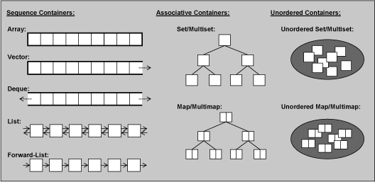
CPSC 131 – Data Structures
Array & Vector Abstract Data Types
Professor T. L. Bettens
Spring 2023

Slide 2
Concepts & Interface
Jusuttis, The C++ Standard Library
6.2. Containers
7.1. Common Container Abilities and Operations
7.2. Arrays
7.3. Vectors
CPPReference.com
Containers library
std::array
std::vector
Implementation Examples
Vector
Student

Slide 3
Array Abstract Data Type
Definitions:
Capacity - max number of elements that can be stored
Size - another name for Capacity – an array’s size does not (can not) change
Fixed Capacity Array
Two flavors
Capacity is constant
Set at container definition at design (compile) time
Standard arrays
Smart wrapper around native array
std::array from the <array> library
Ex: std::array<Student, 10> myArray;
Native arrays
aka C-Style or raw array
AVOID using these
Ex: Student myArray[10];

Slide 4
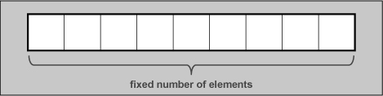
Array Abstract Data Type The Abstraction - What can I do to an Array
std::array
size = 5
capacity = 5
Construct, destruct, assign
Copy, compare
Iterate
Access elements
at, operator[], front, back
Query
empty, size
Operations
----
0 | 1 | 2 | 3 | 4
'\0' | '\0' | '\0' | '\0' | '\0'
myArray
size
capacity

Slide 5
Vector Abstract Data Type
Definitions:
Capacity - max number of elements that can be stored
Size - number of elements that are stored
Fixed Capacity Vector
Extendable Capacity Vector
Capacity is constant
Set at container construction during runtime, or
Set at container definition at design (compile) time
Capacity is dynamic and changes during runtime
Initialized at container construction during runtime
Grows and shrinks during runtime

Slide 6

Vector Abstract Data Type The Abstraction - What can I do to a Vector
Vector
size = 1
capacity = 3
Construct, destruct, assign
Copy, compare
Iterate
Access elements
at, operator[], front, back
Query
empty, size, capacity
Operations
insert, erase, clear, push_back, pop_back
0 | 1 | 2
myVector
'A'
size
capacity

Slide 7
Array ^{vs} Vector – What’s the difference?
Arrays | Vectors
Capacity is constant | Two flavors, Fixed and Extendable Capacity
Size is constant | Size changes
Capacity and Size are always the same | Capacity and Size usually differ
Every cell always contains an element | Some cells do not contain an element
No insert and erase operations | Elements can be inserted and erased
Two template parameters | One template parameter

Slide 8
Array ^{vs} Vector – What’s the same?
Arrays and Vectors
Consecutive locations in memory
Indexed the same way
operator[] may over index avoidance is client’s responsibility
Comparison, assignment, initialization

Slide 9

Vector Implementation Example
main.cpp includes both
Vector.hpp and Student.hpp
Student.cpp includes only
Student.hpp
Vector.hpp
Student.hpp
main.cpp
Student.cpp

Slide 10
In Class Sketching Activity
Using the Implementation Examples, for each of the major operations of Arrays and Vectors, step through the code and sketch the resulting structure

Slide 11
Analysis of the Vector Abstract Data Type Complexity Analysis (1)
Function | Analysis – std::array<T, S> | Analysis – std::vector<T> (Extendable Vector)
at() | O(1) Elements directly indexable | same
size() | O(1) Always returns S, as in std::array<T, S> | O(1) Returns the number of elements held
empty() | O(1) | same
clear() | Not available std::array<T, S> will always have S elements | O(n) All elements are destroyed and size set to zero O(1) if only size set to zero, as in zyBook

Slide 12
Analysis of the Vector Abstract Data Type Complexity Analysis (2)
Function | Analysis – std::array<T, S> | Analysis – std::vector<T> (Extendable Vector)
push_back() | Not available std::array<T, S> will always have S elements | O(n) amortized to O(1) Special case of insert()
erase() | Not available std::array<T, S> will always have S elements | O(n) Have to “close the gap” which means N copies (worst case, N/2 copies average case)
splice | Not available | Not available

Slide 13
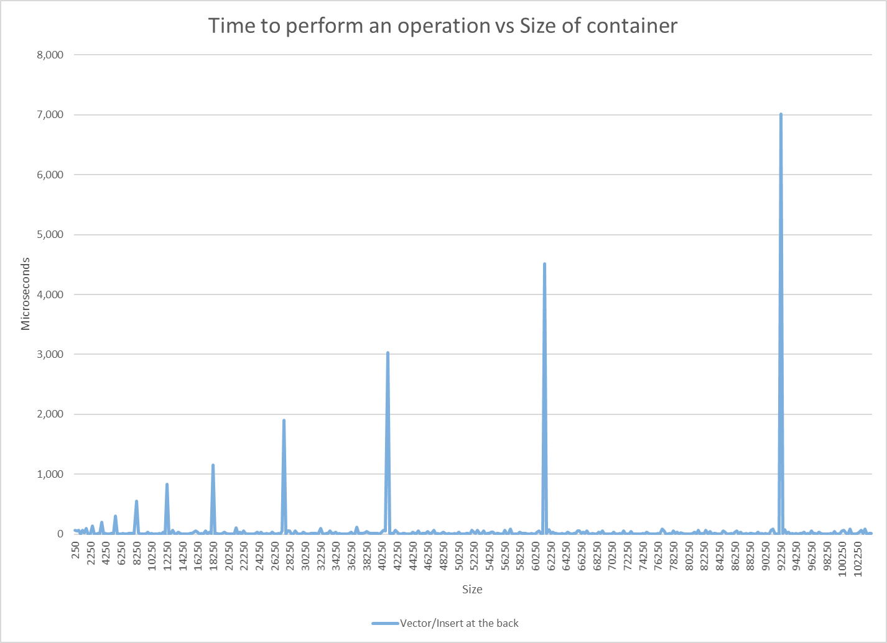
Efficiency Class Example: Amortized O(1)
vector.push_back( data )
The “norm” is constant time
But every now and then consumes linear time
The interval between spikes doubles each time
The severity of the spike increases each time

Slide 14
Analysis of the Vector Abstract Data Type Complexity Analysis (3)
Function | Analysis – std::array<T, S> | Analysis – std::vector<T> (Extendable Vector)
insert() | Not available std::array<T,S> will always have S elements | O(n) (worst case) If space is not available, get more space and copy N elements Destroy N elements “Open a gap” which means N copies
default construction | O(n) container is never empty | O(1) creates an empty container
Equality C₁ == C₂ | O(n) | same

Slide 15
Analysis of the Vector Abstract Data Type Complexity Analysis (4)
Function | Analysis – std::array<T, S> | Analysis – std::vector<T> (Extendable Vector)
push_front | Not available std::array<T, S> will always have S elements | Not available
resize | Not available std::array<T, S> will always have S elements | O(n)
find | O(n) linear search from begin() to end() (i.e. a[0] to a[size()-1]) | same

Slide 16
Analysis of the Vector Abstract Data Type Complexity Analysis (4)
Function | Analysis – std::array<T, S> | Analysis – std::vector<T> (Extendable Vector)
Visit every element e.g. print() | O(n) Visiting every node from begin() to end() | same
Visit in reverse e.g. print_reverse() | O(n) Visiting every node from rbegin() to rend() Direction doesn’t matter | same

